Slide 1
Symphony
The Symphony data acquisition solution is broken up into 4 distinct parts.
Devices connected to the Heka board
Multiclamp, Axopatch, LED board etc…….
Devices connected to the computer
The solution controller
The underlying library (symphony-core) that connects to the multiclamp and devices connected to the HEKA board
The user interface, SymphonyUI

Slide 2
Symphony-UI
Solution
Controller
Symphony-Core
MultiClamp, Heka Device, LED Controller, Rig Switches etc…

Slide 3
Symphony-Core
Written by Barry (Physion Software)
Written in C# (To view the files we have Visual Studio Express)
This is the underlying library that connects to the HEKA board and MultiClamp device.
Location on the computer:
C:\Program Files\Physion\Symphony
The only thing I have ever edited in the Symphony-core code is to allow symphony core to connect to the axopatch.
YOU WILL NOT NEED TO EDIT THESE FILES

Slide 4
Symphony-UI
This is Broken up into two parts
The main Symphony-UI code
Petri’s Lab Symphony-UI extensions
Symphony-UI
Main
Petri
These files all have to be in the MATLAB Path
EXCEPT for the Stubs folder. (This is designed as the device simulator when programming on a mac)

Slide 5
Symphony-UI
Main
This is primarily written by Mark
Location on the computer
C:\Program Files\Physion\Symphony - UI\Symphony
To add a few of the features, I have edited –
SymphonyProtocol.m
SymphonyUI.m
editParameters.m
I will document these changes, so that as I have tried to keep them to a minimum
future integration of the current version is simple.

Slide 6
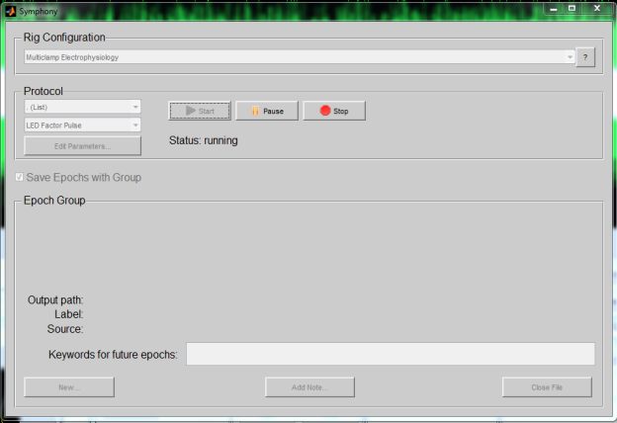
Symphony-UI
Main
KEY FILES
StartSymphony.m
This is the launching script. (To launch Symphony, in Matlab type: “StartSymphony”)
SymphonyUI.m
This is the code for the main graphical user interface

Slide 7
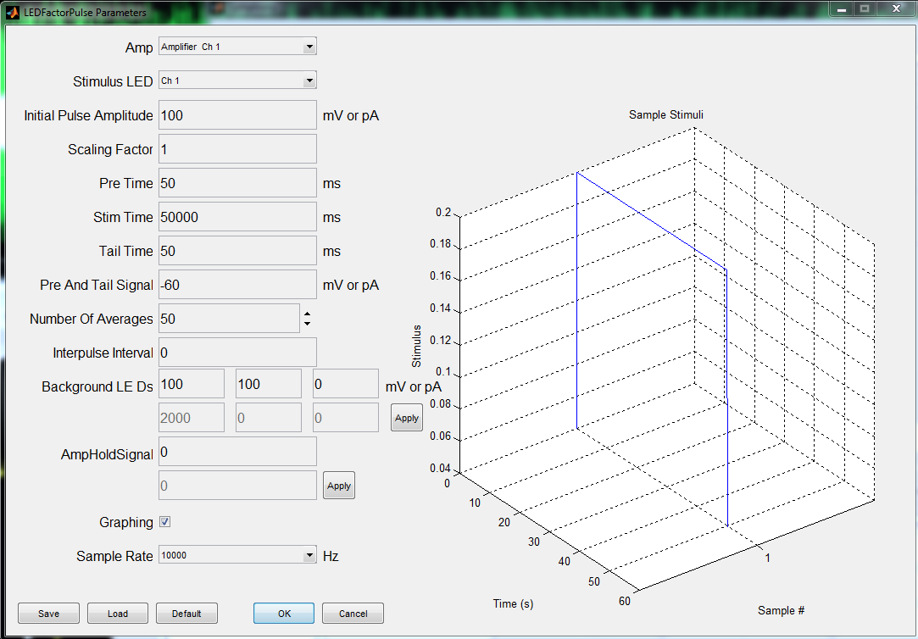
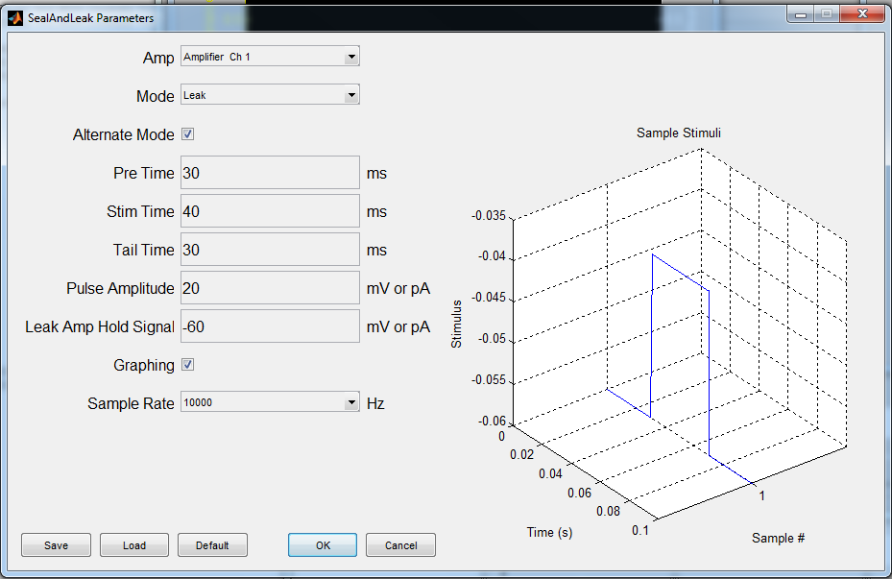
Symphony-UI
Main
KEY FILES
editParameters.m
This is the code that generates the “edit parameters” window. I edited this file to allow for the background LED functionality and the ability to set the amplifier hold signal

Slide 8
Symphony-UI
Main
KEY FILES
RigConfiguration.m
This is where the Symphony-UI establishes the connection to the HEKA controller, MultiClamp Amplifier and registers all devices connected to the HEKA board. This will be an important file to get a basic understanding of, as in the Petri SymphonyUI code, we subclass this file.
SymphonyProtocol.m
This is the heart of the SymphonyUI application. This is the class that runs the protocol. This will be an important file to get a basic understanding of, as in the Petri SymphonyUI code, we subclass this file to create our protocols.

Slide 9
Symphony-UI
Main
KEY FILES
WE DON NOT USE:
Figure Handlers (I created my own because the functionality was to basic and to complicated to customize)
The other files not mentioned are not as important for me to explain, but if you want you can look over them.

Slide 10
Symphony-UI
Petri
This is all written by me
Location on the computer
C:\Users\Dunkerley\Documents\MATLAB\Symphony – Util & there are a couple of files in the users path C:\Users\Dunkerley\Documents\MATLAB
This is the main part of the code that you are required to know, for example:
Creating/editing our labs rig configurations
Creating/editing protocols
Creating/editing new plot
Adding new functionality
This is also where the generated files are kept

Slide 11
Symphony-UI
Petri
Key Folders
C:\Users\Dunkerley\Documents\MATLAB\Symphony - Util\Acquasitions
This is where the h5 files generated by symphony-core are stored
C:\Users\Dunkerley\Documents\MATLAB\Symphony - Util\Notes Files
This is where the generated notes files are stored
C:\Users\Dunkerley\Documents\MATLAB\Symphony - Util\.Hidden Notes Files
Is a hidden windows folder that stores the notes files as well
C:\Users\Dunkerley\Documents\MATLAB\Symphony - Util\Header Files
This is where you store log header files for various experiments. You can load these through the logger GUI before the experiment starts.
C:\Users\Dunkerley\Documents\MATLAB\Symphony - Util\Example Protocols
This is a folder that contains example protocols
NOTE: With the changes made, these will not run. They are there for just a guide.

Slide 12
Symphony-UI
Petri
Key Folders
C:\Users\Dunkerley\Documents\MATLAB\Symphony - Util\ExternalApps
This is where code is stored for custom applications written to work with the SymphonyUI. (The logging application, the solution controller application)
C:\Users\Dunkerley\Documents\MATLAB\Symphony - Util\Figure Handlers
This is where the code for our plots are
C:\Users\Dunkerley\Documents\MATLAB\Symphony - Util\Protocols
This is where code for our labs protocols are.
C:\Users\Dunkerley\Documents\MATLAB\Symphony - Util\Rig Configurations
This is where the code for our labs rig configurations are.

